Slide 1

Introduction to JavaScript
JavaScript is a high-level, interpreted scripting language primarily used to create interactive web pages. It works in conjunction with HTML and CSS to build dynamic and engaging user experiences. While originally designed for client-side scripting, JavaScript has expanded its reach to server-side development with platforms like Node.js.
1. High-level: JavaScript is designed to be easy to read and write, abstracting away low-level details and providing developers with a more intuitive syntax.
2. Interpreted: JavaScript code is executed line by line by an interpreter, rather than being compiled into machine code before execution. This allows for rapid development and easy debugging but may result in slightly slower performance compared to compiled languages.
3. Scripting Language: JavaScript is often used for scripting tasks, especially within web development. It's commonly embedded within HTML pages and executed by web browsers to provide dynamic and interactive functionality and so on……………….

Slide 2
Why Learn JavaScript?
Versatility and Demand
JavaScript is the language of the web. It's used for everything from simple website animations to complex web applications, mobile apps, and even server-side development. Its widespread use makes it highly in-demand by employers.
Ease of Learning
Compared to other programming languages, JavaScript has a relatively gentle learning curve. Its syntax is intuitive, making it accessible to beginners.
Community Support
JavaScript boasts a massive and active community of developers. This means plenty of resources, tutorials, and forums are available to help you learn and grow as a programmer.
Career Opportunities
Due to its versatility and high demand, learning JavaScript can open doors to a variety of career paths, from front-end and back-end development to full-stack roles.

Slide 3
What is JavaScript?
Definition:
JavaScript is a versatile, high-level scripting language primarily used to create and control dynamic website content.
It is an essential part of web development, enabling interactive features like animations, form validations, and dynamic updates without reloading the page.
Functionality:
JavaScript runs in the browser and allows developers to manipulate the Document Object Model (DOM) to create interactive web experiences.
It supports object-oriented, imperative, and functional programming styles.
JavaScript can handle events, validate data, interact with APIs, and perform complex computations in real-time.

Slide 4
Applications Beyond Web Development
Server-Side Development:
JavaScript is used in server-side programming with platforms like Node.js, allowing developers to build scalable network applications.
It enables JavaScript to run on servers, handling requests and managing data.
Mobile App Development:
JavaScript frameworks like React Native and Ionic allow developers to create cross-platform mobile applications.
These apps run on both iOS and Android devices using a single codebase.
Desktop Applications:
Electron is a popular framework for building desktop applications with JavaScript, HTML, and CSS.
Notable applications like Visual Studio Code and Slack are built using Electron.

Slide 5
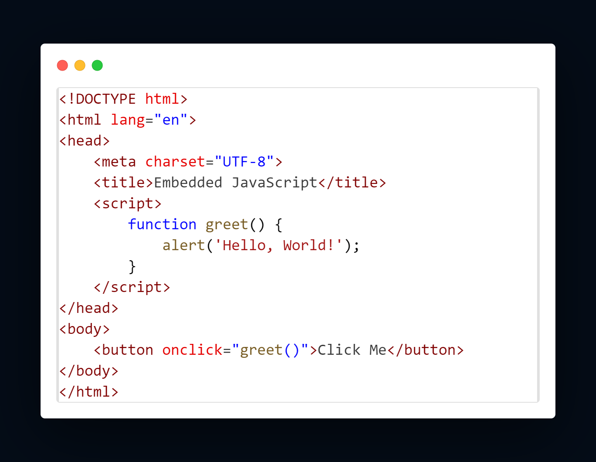
JavaScript Integration
Embedding Code within <script>...</script> Tags
JavaScript code can be embedded directly within HTML documents using the <script> tag. This method is useful for small scripts or when the code is specific to a single page.
Example:

Slide 6
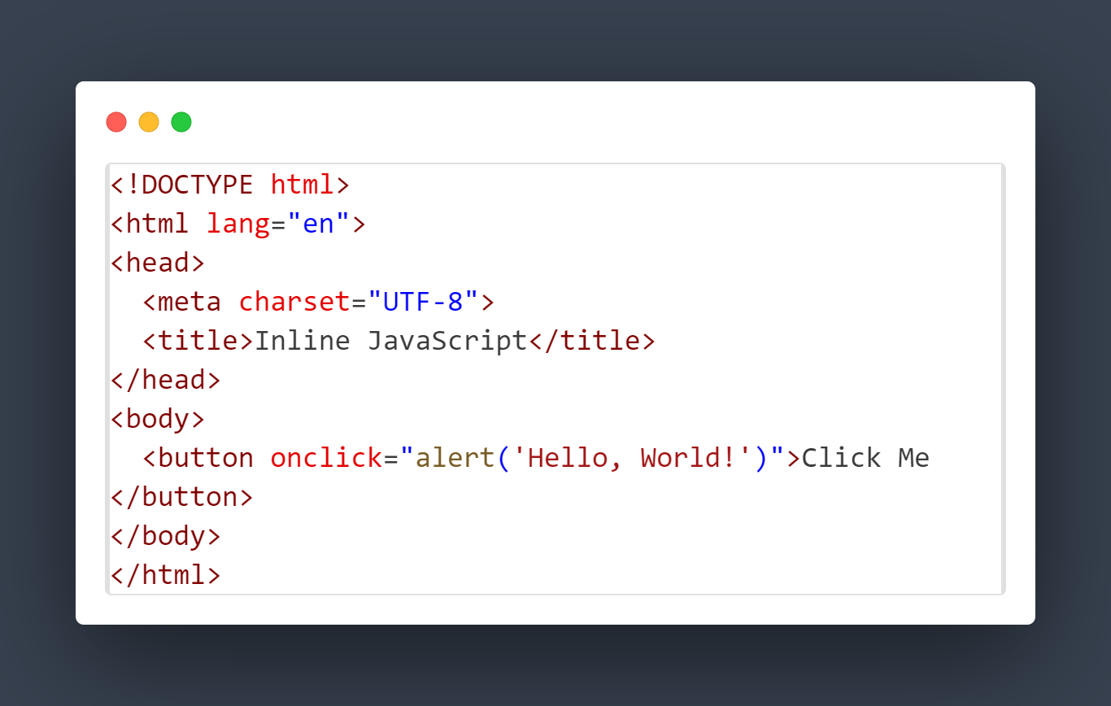
JavaScript Integration
Inline Code Placement Using Special Attributes
JavaScript can also be included inline within HTML tags using special attributes such as onclick, onmouseover, and others. This method is often used for simple, event-driven scripts.
Example:

Slide 7
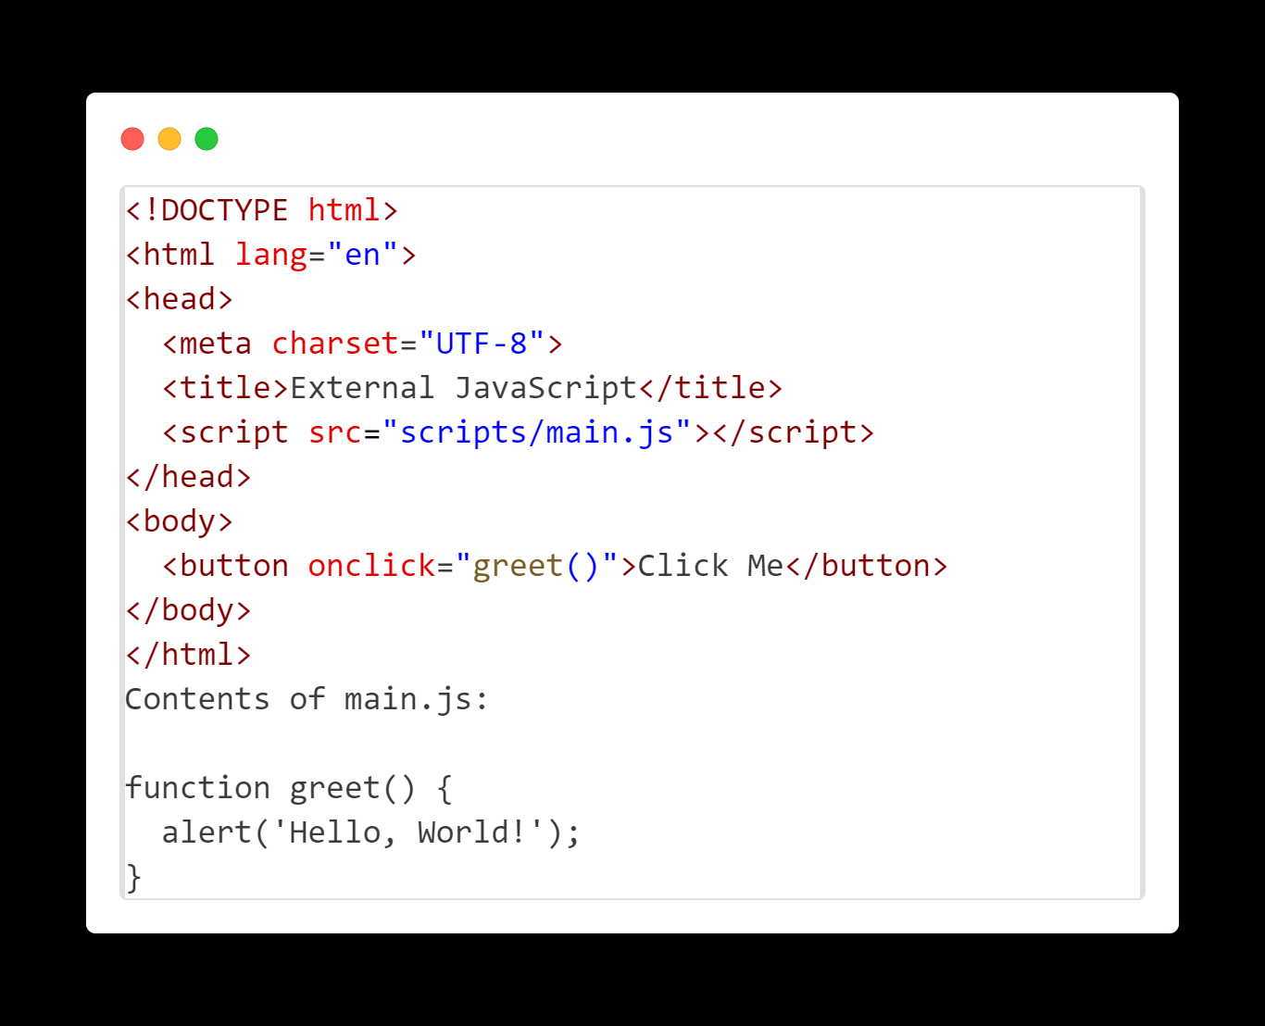
JavaScript Integration
External File Linking with .js Extension
For larger scripts or when the same JavaScript code needs to be used across multiple pages, it is best practice to link to an external JavaScript file. This approach improves maintainability and website performance.
Example:

Slide 8
Conclusion
In summary, JavaScript is a highly versatile and in-demand programming language that plays a crucial role in modern web development. Its ease of learning, coupled with strong community support, makes it accessible to beginners while offering powerful capabilities for experienced developers. Mastery of JavaScript opens up diverse career opportunities, from web development to mobile app creation, server-side programming, and beyond.
When integrating JavaScript into HTML, there are three primary methods to consider: embedding code directly within <script> tags, using inline code within HTML elements for simple event handling, and linking external JavaScript files for larger and reusable code. Each method has its specific use cases and benefits, contributing to a more efficient and maintainable development process.
Overall, learning JavaScript is an investment in your development career, providing a solid foundation for further exploration and specialization in various technological fields.

